Slide 1

MOHI – MADOYA STAFF TRAINING
Cybersecurity Awareness & Educational Technology

Slide 2
What is Cybersecurity?
Cybersecurity means protecting computers, phones,
and school information from people who want
to steal or damage it.
Examples of school data:
• Student records
• Staff information
• School emails
• Financial information

Slide 3
Why Cybersecurity is Important
Schools store important information.
If attackers access it they can:
• Steal student information
• Change records
• Send fake emails
• Disrupt school systems

Slide 4
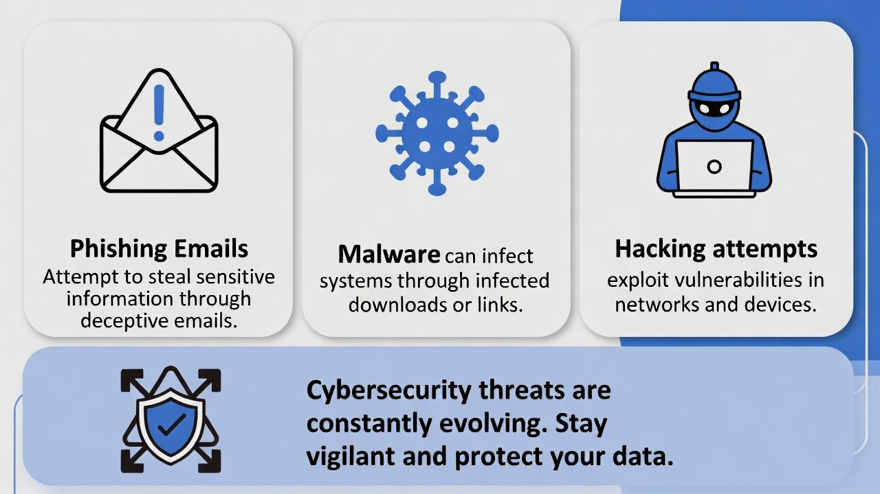
Common Cyber Threats
Some common threats
include:
• Phishing emails
• Malware and viruses
• Hacking attempts
• Weak passwords
• Unsafe downloads

Slide 5
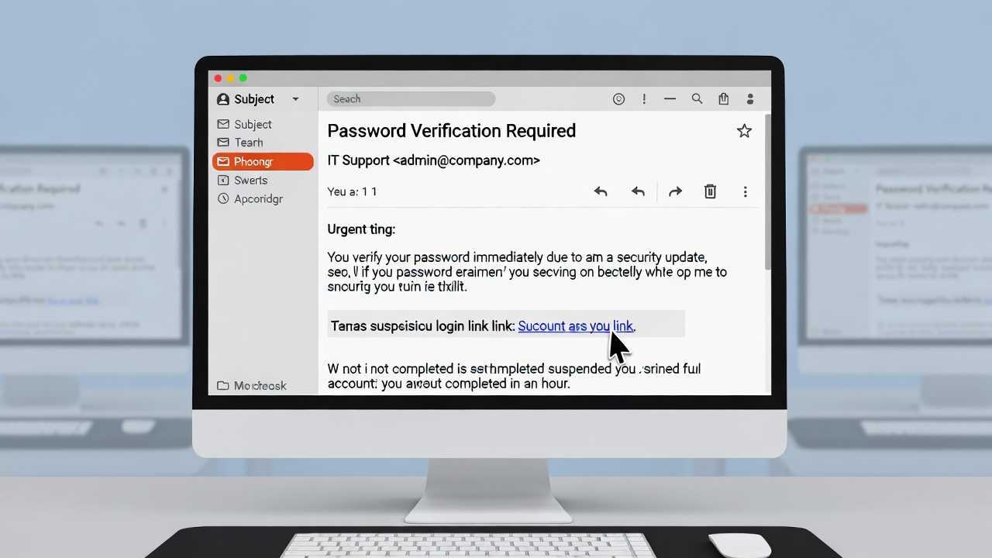
What is Phishing?
Phishing is when someone sends a fake email trying to trick you into giving your password or
personal information.
Example:
An email asking you to
'verify your password'.
Always check before
clicking links.

Slide 6
What is Social Engineering?
Social engineering happens when attackers trick
people into revealing information.
Examples:
• Fake IT support calls
• Emails pretending to be administrators
• Someone asking for your password

Slide 7
What is Malware?
Malware is harmful software that can damage
computers or steal information.
It may come from:
• Suspicious downloads
• Infected USB drives
• Email attachments

Slide 8
Strong Passwords
Good password practices:
• Use longer passwords
• Avoid simple passwords
• Do not share passwords
• Do not reuse passwords everywhere

Slide 9
Protecting School Data
Simple actions that help protect school data:
• Lock computers when leaving
• Avoid suspicious links
• Keep student information private
• Report unusual activity to IT

Slide 10
Everyone Has a Role
Cybersecurity is not only for the IT department.
Teachers and staff help keep systems safe by:
• Following security practices
• Reporting suspicious activity
• Protecting login information

Slide 11
Conclusion
By understanding cybersecurity
and using technology responsibly,
we can create a safer learning
environment for students and staff.

Slide 12
Thank you

